Slide 1



GUIDE TO USING THE PROFESSIONAL DEVELOPMENT PLATFORM
Navigation, troubleshooting and FAQs
Public

Slide 2


CONTENTS
NAVIGATION
Home page
HE Provider Learning Dashboard
Adviser Dashboard
Your record of learning
The course catalogue
Accessibility tools
COURSES
Layout
Activity navigation
TROUBLESHOOTING
FAQs
Public

Slide 3

NAVIGATION
Home page and dashboards.
Public

Slide 4

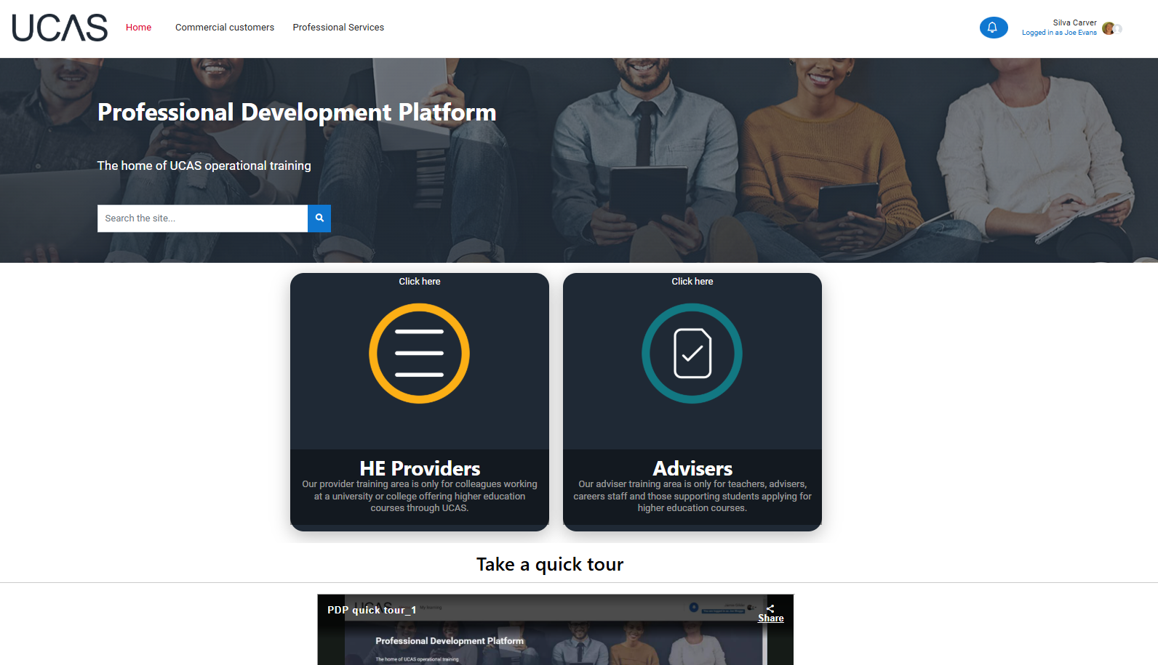

HOME PAGE
Your user profile
Search for courses by title, topic or phrase
Dashboard for admissions and marketing staff at universities and colleges
Dashboard for teachers and advisers at schools, colleges and UCAS Registered centres
Quick video tour
Public

Slide 5
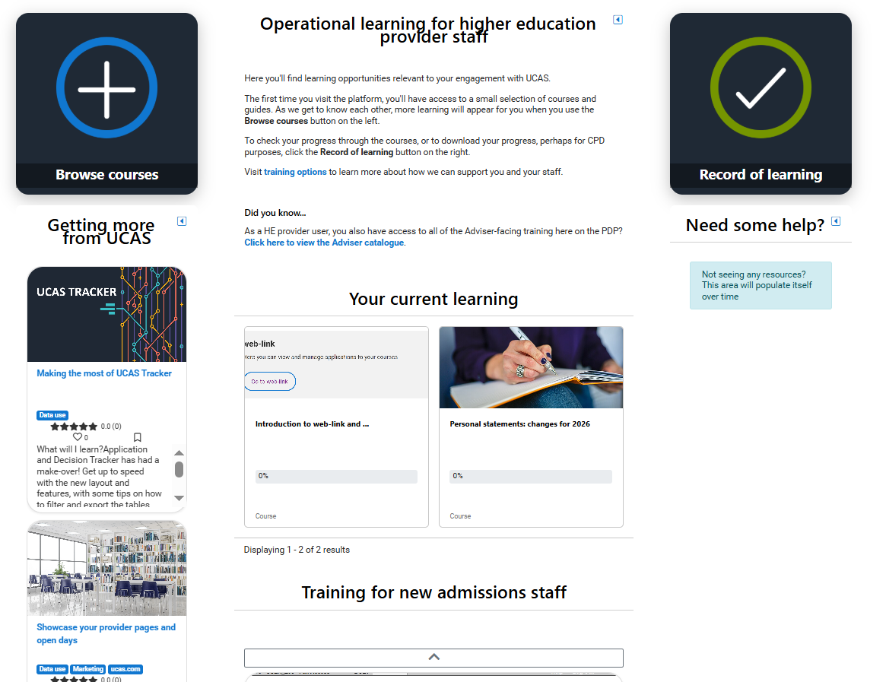

HE PROVIDER LEARNING DASHBOARD
Your record of completed courses
Browse the full HE Provider catalogue here
Courses you are enrolled on but have not completed
View the Adviser catalogue here
Suggested courses
Public

Slide 6
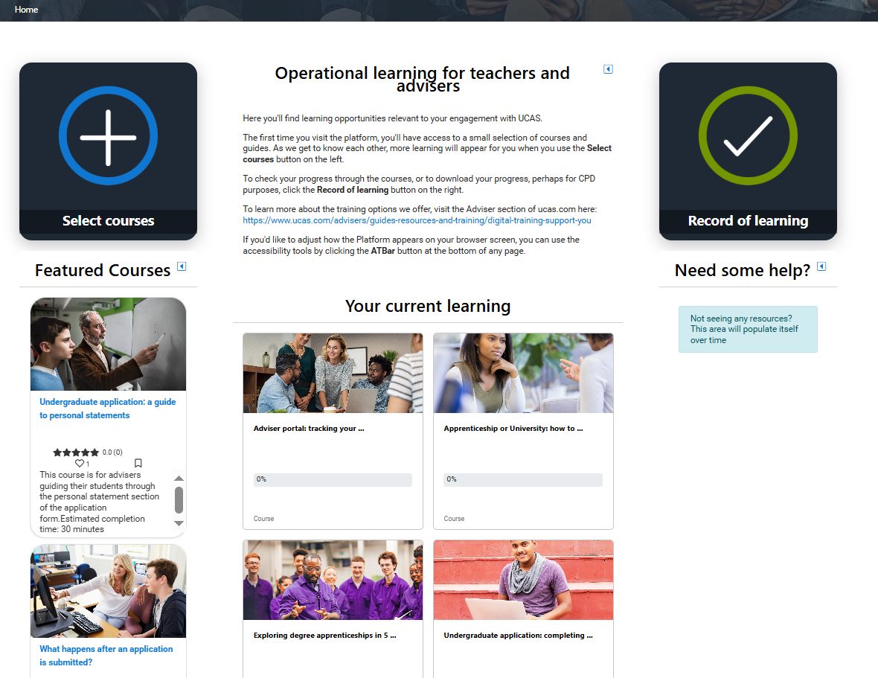

ADVISER LEARNING DASHBOARD
Your record of completed courses
Browse the full Adviser catalogue here
Courses you are enrolled on but have not completed
Suggested courses
Public

Slide 7
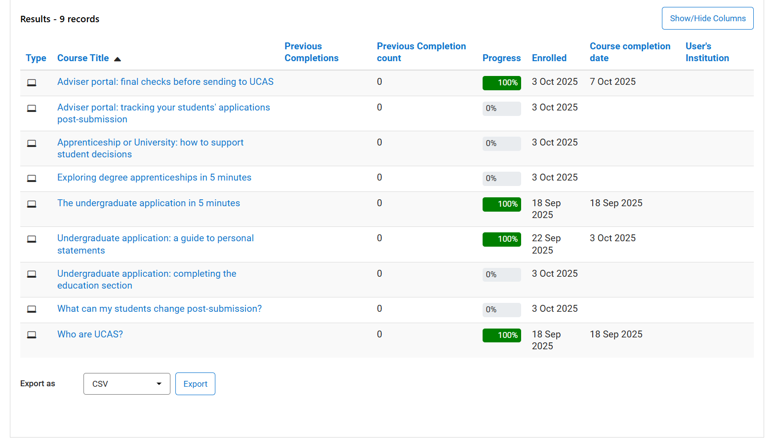

YOUR RECORD OF LEARNING
Your completion status shows in green – we can only show this if you accept all cookies when prompted
Courses no longer available will show in grey
You can download your record as a pdf, .csv or .xls file
Public

Slide 8
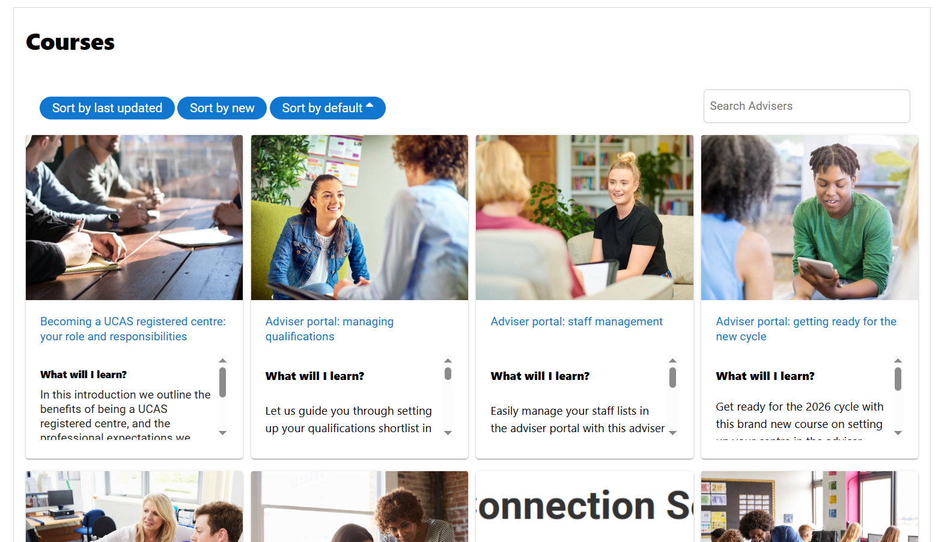

THE COURSE CATALOGUE
Change the sort order
Search by title, topic or phrase
Click on a course card to view more details and enrol
Public

Slide 9


ACCESSIBILITY TOOLS
At the bottom of every page, you’ll see the Atbar - click to open the tools menu
You can:
Increase/decrease text size
Change background or contrast colour
Use the text-to-speech feature
Change the font setting for the page
Public

Slide 10
NAVIGATION
Courses.
Public

Slide 11
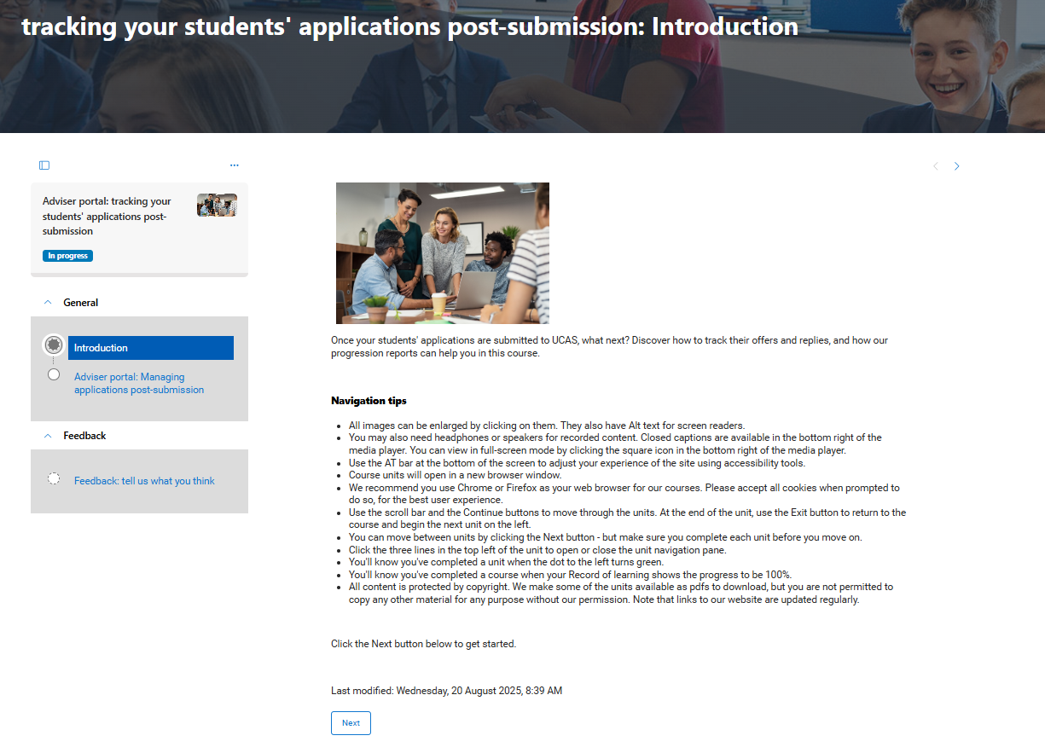
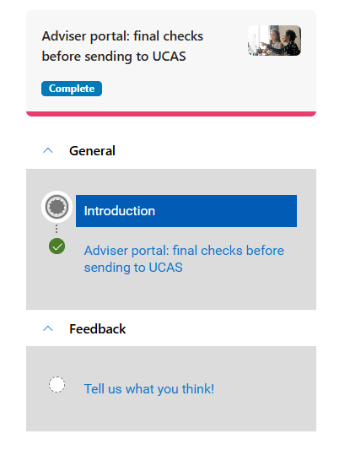
COURSES
Completed units will show a green dot, and the status under the course title will update as you progress
We use a pathway layout for our courses, which shows your progress on the left of the screen
Feedback is optional – but we love it!
11
Public

Slide 12
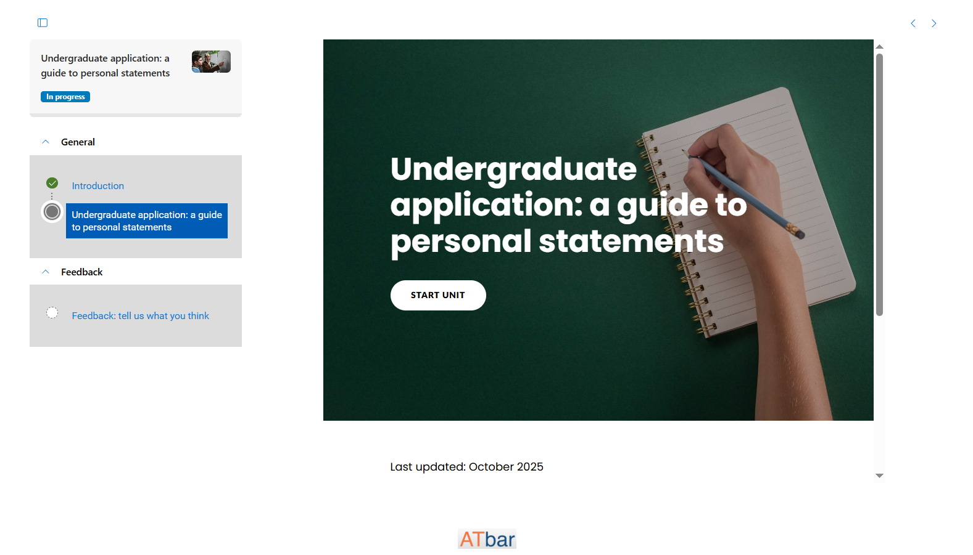
COURSES
Click the menu icon to hide the pathway and make the course pane bigger
Most of our course activities are created using Articulate360 software - click the button to start, and scroll to view the section content
Course activities open in a new browser window
12
Public

Slide 13
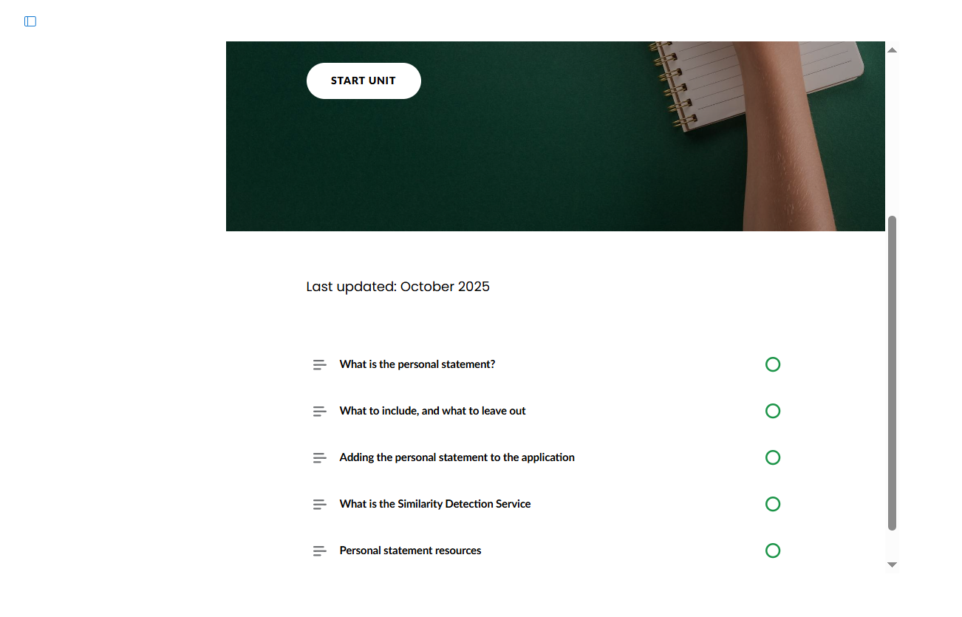
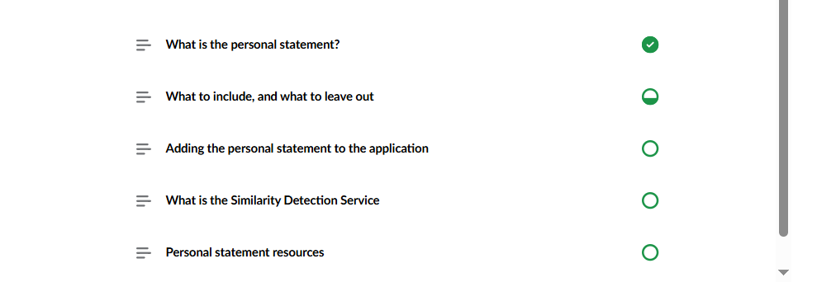
COURSES
Click the menu icon to open the pathway again
Activity sections will turn green when completed
13
Public

Slide 14
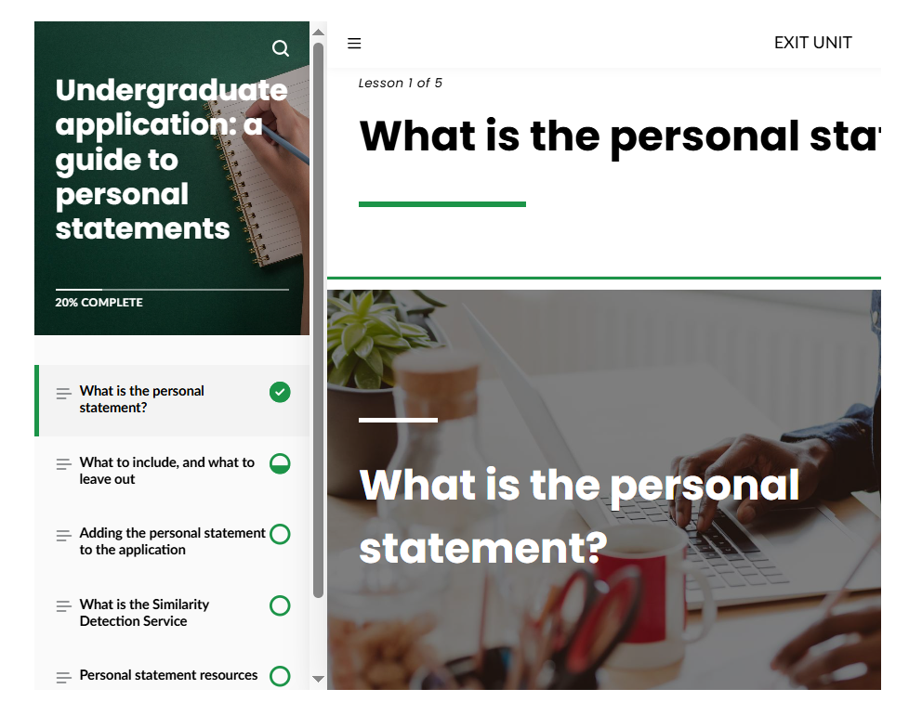
COURSES
Once inside the activity, click the 3 horizontal bars to open and close the Activity menu
Use the EXIT UNIT link to save your progress
14
Public

Slide 15
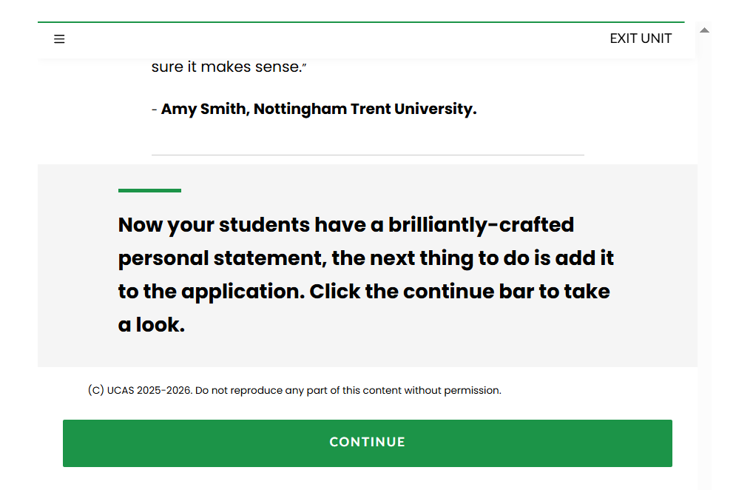
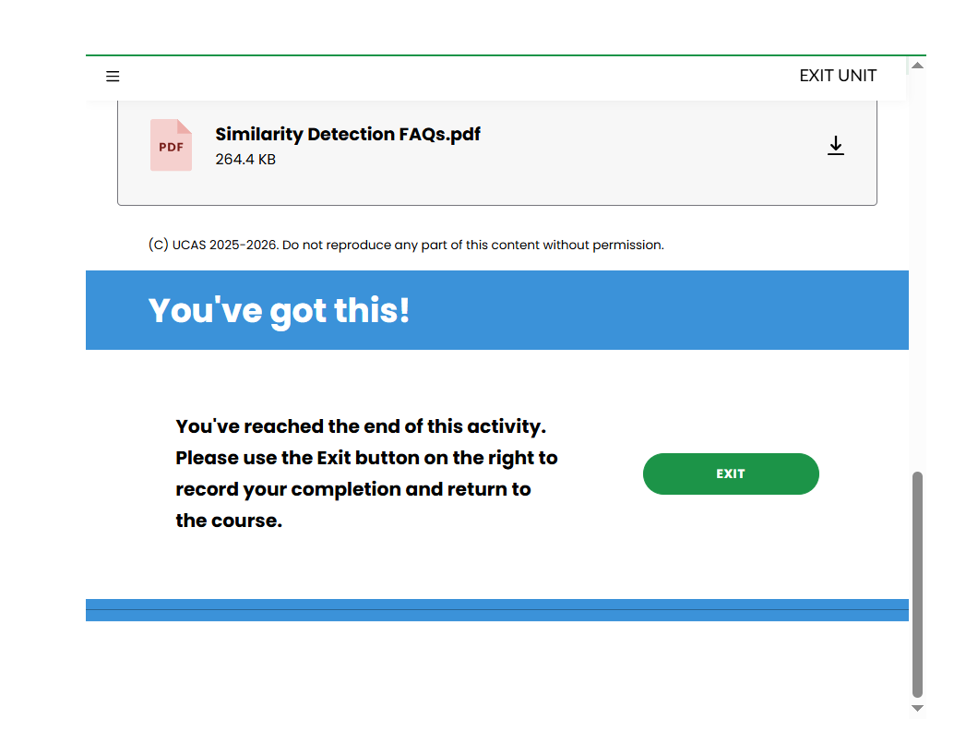
COURSES
Click the solid Continue bars to move through the activity – they sometimes have different words on them, such as “Let’s go…”
You’ll know when you reach the end of the activity – click the Exit button to record your completion
15
Public

Slide 16
TROUBLESHOOTING
Public

Slide 17
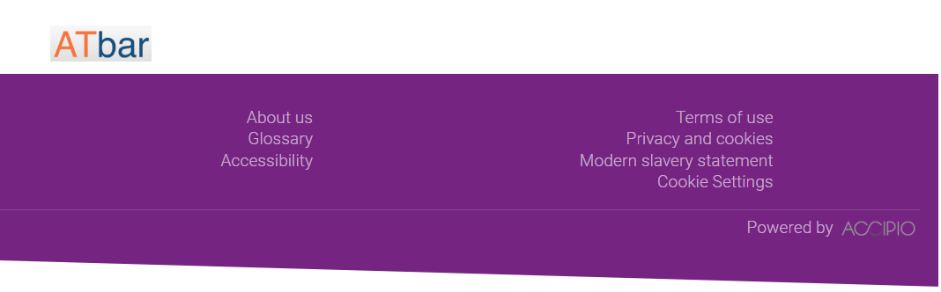
MY DASHBOARD WON’T FULLY LOAD
If you get a spinning ‘loading’ wheel on your dashboard, this is usually because your cookie settings need to be updated.
Go to the bottom of any page and click Cookie Settings
17
Public

Slide 18
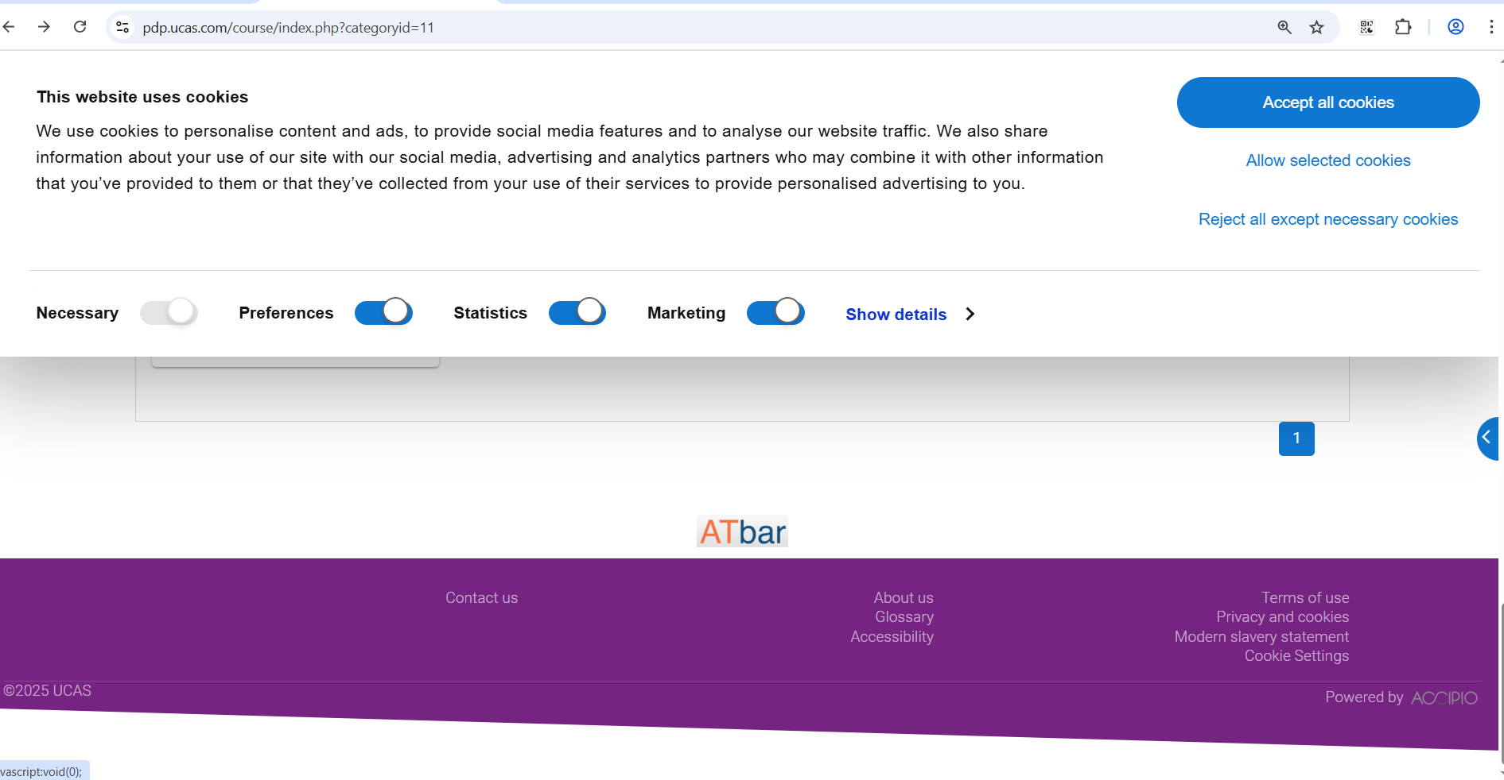
Please accept all so that the Platform features work as expected
18
Public

Slide 19
FAQs
Public

Slide 20
WHO IS THE PROFESSIONAL DEVELOPMENT PLATFORM FOR?
The Platform is designed for use by a variety of customer groups:
  Teachers and advisers around the world supporting students in applying to UK higher education courses.
  Higher education university and college staff who may be either supporting applicants or managing and making decisions on applications.
  Business partners who work with UCAS to develop new products and services.
  UCAS staff for their own training and development.
DO I HAVE TO COMPLETE ONE COURSE BEFORE STARTING ANOTHER?
No, that's the benefit of the modular design of our learning, you can choose which activities you wish to complete, and most are small enough to finish in a single sitting of 5-15 minutes.
Plus, if you use the Exit course link in the top right of any course, your progress will be saved. This means you can pick up where you left off the next time you visit the platform!
20
Public

Slide 21
WILL I GET A CERTIFICATE WHEN I COMPLETE A COURSE?
UCAS does not currently award certificates on any of our training courses. However, some courses, or combinations of courses, do lead to the award of a badge. Any badges you achieve will appear on your dashboard.
You can also download your record of learning as a .csv, .xlsx, or pdf.
CAN I ACCESS THE PLATFORM AT HOME?
Yes, it's designed to work on many devices so you can access it at home or on the move. We request that you use a work email address when registering on ucas.com, so that we can connect you to your organisation in our records and ensure that you can access the appropriate training materials for your role.
21
Public

Slide 22
IS MY LINE MANAGER ABLE TO SEE THE COURSES I HAVE COMPLETED?
With the exception of the annual Results Embargo Training for HE provider staff, and any specific agreement we may have from time to time with individual organisations, we do not share individual external user training records with anyone.
When you are logged in, you will be able to see a record of the training you have completed through the Record of learning button on your dashboard. You can download the report for your records in a number of different formats to share with your line manager.
WHO CAN I CONTACT ABOUT ENROLLING COLLEAGUES ONTO COURSES?
You can email us at training@ucas.ac.uk to discuss your staff training needs.
22
Public

